Slide 1
Energy Consumption Forecasting &
QA Chatbot

Slide 2
Contents
Energy Consumption Forecasting & Anomaly Detection and LLM Model for Reducing Electricity Bills
Project Overview
Project Scope
Data Collection
Data Preprocessing
Exploratory Data Analysis
Model Development

Slide 3

Project Overview
Objective:
Forecast energy consumption to enable better planning and optimization.
Develop an LLM-based system to provide recommendations on reducing electricity bills.

Slide 4
Project Scope
Energy Consumption Forecasting: Use time series forecasting to predict future energy usage.
LLM Model for Recommendations: Create a language model to provide actionable insights on reducing energy bills.

Slide 5
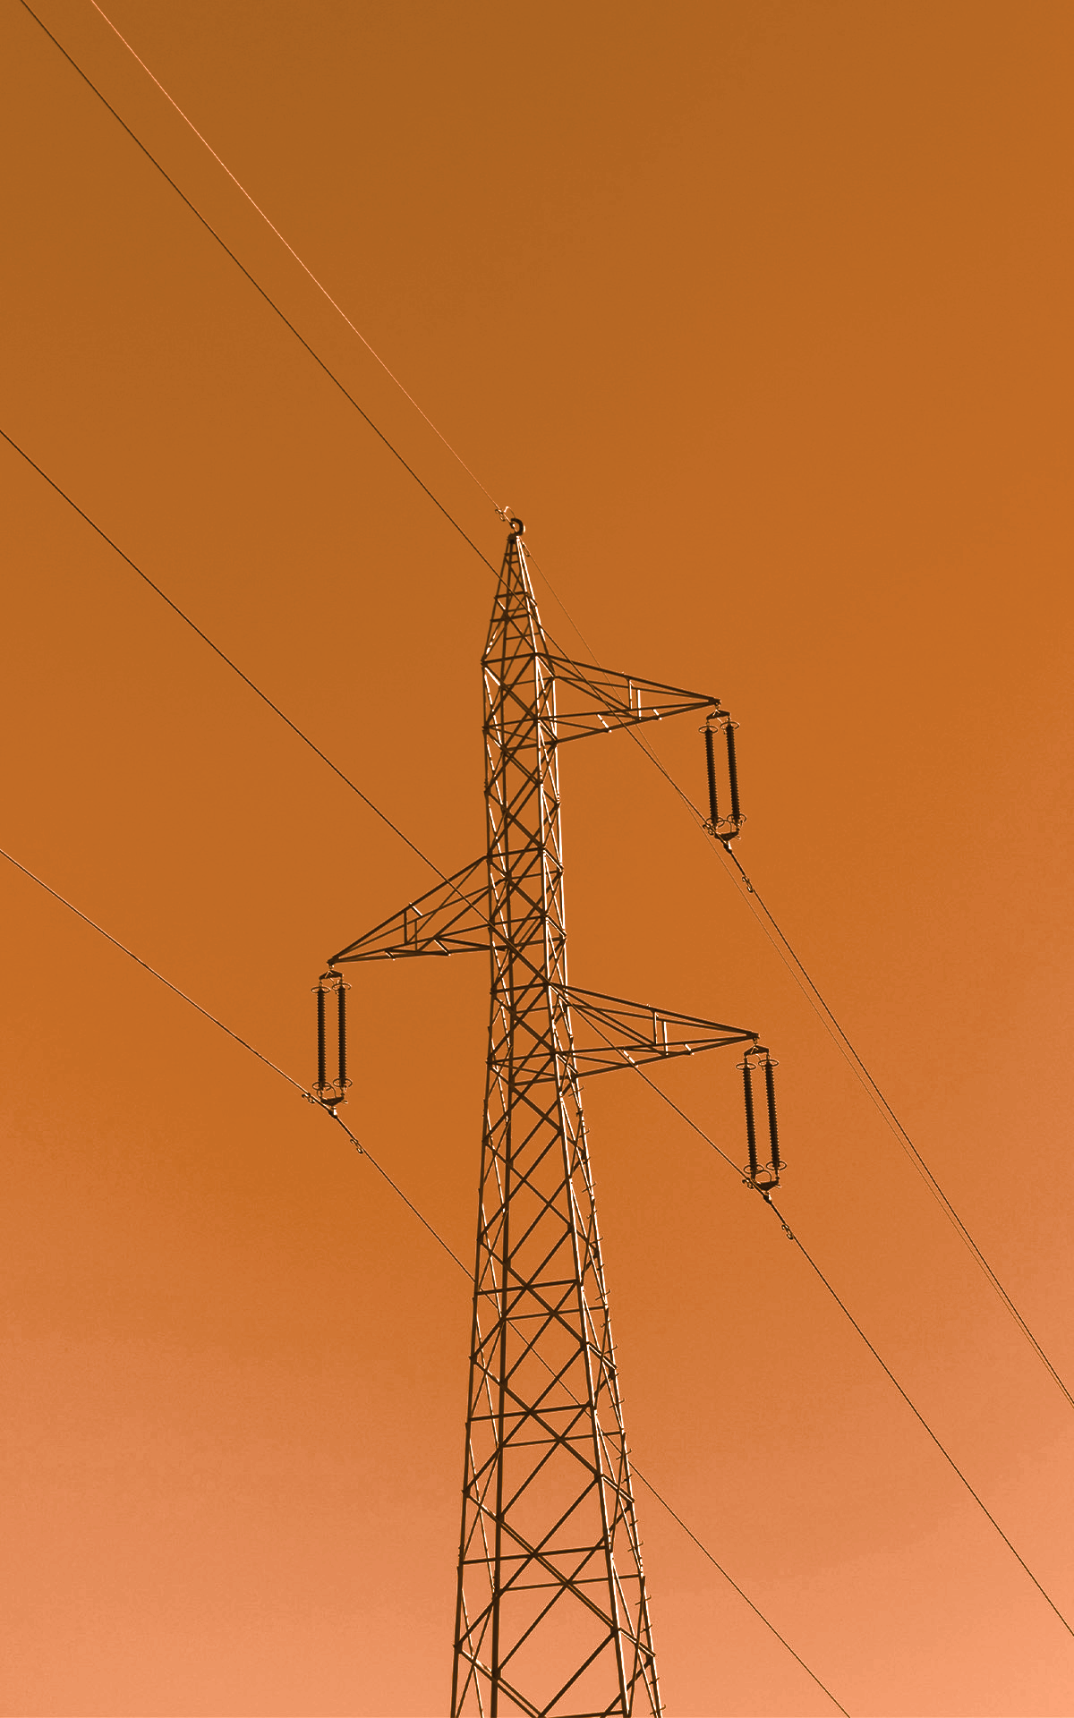
Data Collection
Datasets:
Energy Consumption
Buildings Energy Consumption Dataset
https://www.kaggle.com/datasets/arashnic/building-sites-power-consumption-dataset/data
LLM-based system Dataset
Ways to Reduce Electricity Bill
100 ways to save energy at home
100 ways to reduce energy usage
Tips on energy saving
Publications distributed to participats
Energy savers

Slide 6
About
Buildings Energy Consumption Dataset
Data and Problem Description
More accurate forecasts of building energy consumption mean better planning and more efficient energy use. So The objective is to forecast energy consumption from following data: (For each data set, several test periods over which a forecast is required will be specified.)
Historical Consumption
A selected time series of consumption data for over 260 buildings.
-obs_id - An arbitrary ID for the observation -SiteId - An arbitrary ID number for the building, matches across datasets -ForecastId - An ID for a timeseries that is part of a forecast (can be matched with the submission file) -Timestamp - The time of the measurement -Value - A measure of consumption for that building
Building Metadata
Additional information about the included buildings.
-SiteId - An arbitrary ID number for the building, matches across datasets -Surface - The surface area of the building -Sampling - The number of minutes between each observation for this site. The timestep size for each ForecastId can be found in the separate "Submission Forecast Period" file on the data download page. -BaseTemperature - The base temperature for the building -IsDayOff - True if DAY_OF_WEEK is not a work day

Slide 7
Historical Weather Data
This dataset contains temperature data from several stations near each site. For each site several temperature measurements were retrieved from stations in a radius of 30 km if available. Note: Not all sites will have available weather data.
Note: Weather data is available for test periods under the assumption that reasonably accurate forecasts will be available to algorithms that the time that we are attempting to make predictions about the future.
-SiteId - An arbitrary ID number for the building, matches across datasets -Timestamp - The time of the measurement -Temperature - The temperature as measured at the weather station -Distance - The distance in km from the weather station to the building in km
Public Holidays
Public holidays at the sites included in the dataset, which may be helpful for identifying days where consumption may be lower than expected.
Note: Not all sites will have available public holiday data.
-SiteId - An arbitrary ID number for the building, matches across datasets -Date - The date of the holiday -Holiday - The name of the holiday

Slide 8
Data Preprocessing
Data Cleaning:
Handle missing values.
Remove duplicates.
Correct any inaccuracies in the data.
Data Integration:
Merge datasets based on timestamps.
Align weather data with energy consumption data.
Feature Engineering:
Create new features such as daily average temperature, humidity, and weekday/weekend indicators.
Normalize/standardize data if necessary.

Slide 9
Exploratory Data Analysis (EDA)
Visualizations:
Time series plots for energy consumption.
Correlation heatmaps for features.
Histograms and boxplots for distribution analysis.
Insights:
Identify trends, seasonality, and cycles in energy consumption.
Detect any initial anomalies or outliers.

Slide 10
Model Development
▢ Energy Consumption Forecasting
Model Selection:
↣ VAR
↣ Prophet
↣ LSTM/GRU (for deep learning-based forecasting)
↣ Linear Regression
Model Training:
↣ Splitting data into training and testing sets.
↣ Training models using historical data.
↣ Validating models using cross-validation techniques.
Model Evaluation:
↣ Use metrics such as MAE, RMSE, and MAPE.
↣ Compare performance across different models.

Slide 11
▢ LLM Model for Recommendations
Data Preparation:
↣ Gather a corpus of text related to energy-saving tips, guidelines, and best practices.
RAG Algorithm:
↣ Use a pre-trained language model (e.g.,MiniLLaMA).
↣ Creating prompt using give PDF files
System Development:
↣ Develop an interface for user queries.(using Steamlit)
↣ Integrate the model to provide recommendations based on user inputs.
↣ Example queries: "How can I reduce my electricity bill?" or "What are some tips to save energy in summer?"

Slide 12
Workflow
Define a Problem
Data Collection
Data Preprocessing
Model Training
Model Selection
EDA
Model Evaluation
Hyper Parameter Tunning
Model Deployment
Monitoring & Maintaining

Slide 13
Business Impact:
Cost Savings: Identified cost-saving opportunities through anomaly detection and personalized recommendations.
Operational Efficiency: Improved operational efficiency by leveraging predictive insights for proactive maintenance and energy management.
Sustainability Goals: Contributed to sustainability goals by optimizing energy usage and reducing carbon footprint.
Future Work:
Model Enhancement: Continuously refine models with new data and advanced algorithms for even greater accuracy and reliability.
Integration: Expand the system to integrate with other smart home or building management systems for a holistic approach to energy management.
User Feedback Loop: Incorporate more user feedback to further tailor recommendations and improve the user experience.
Final Thoughts:
The project demonstrates the powerful combination of advanced analytics and machine learning in addressing real-world challenges in energy management.
By leveraging data-driven insights and AI technologies, we can not only achieve significant cost savings but also contribute to broader sustainability efforts.

Slide 14
Project Completion Report: Energy Consumption Forecasting and QA Chatbot
Project Title: Energy Consumption Forecasting and QA Chatbot
Project Duration: 5 weeks
1. Project Overview
The Energy Consumption Forecasting and QA Chatbot project aimed to develop an intelligent system capable of accurately predicting energy consumption and providing a user-friendly interface for answering energy-related queries. The project utilized machine learning techniques and advanced language models to achieve these goals.
2. Objectives
Energy Consumption Forecasting: To create an accurate model for predicting energy consumption based on historical data, temperature, working days, and other relevant factors.
QA Chatbot Development: To design a chatbot that can answer queries related to energy efficiency using a large language model (LLM).
Deployment: To deploy the forecasting model and chatbot on a Streamlit web application for easy accessibility.
3. Technical Implementation
Forecasting Model:
Model Used: Prophet
Performance: The Prophet model was chosen after comparing various models such as LSTM, VAR, and Linear Regression. The Prophet model demonstrated superior performance, covering 86% to 92% of the data accurately.
Data Used: The model was trained using historical energy consumption data, which included features like temperature, working days, and other relevant factors.

Slide 15
QA Chatbot:
Model Used: MiniLLaMA
Functionality: The chatbot was designed to answer user queries regarding energy consumption, efficiency tips, and related topics. MiniLLaMA was selected due to its lightweight nature and effective performance in natural language understanding.
4. Deployment
The entire project was deployed on a Streamlit application, allowing users to interact with both the forecasting model and the chatbot through an intuitive web interface.
5. Results
Forecasting Accuracy: The Prophet model provided accurate predictions with coverage ranging from 86% to 92%.
Chatbot Effectiveness: The chatbot efficiently handled a wide range of energy-related questions, providing users with valuable insights and information.
6. Conclusion
The Energy Consumption Forecasting and QA Chatbot project was successfully completed within the planned 5-week timeframe. The project not only met its objectives but also provided a robust solution for energy consumption forecasting and query answering, with a high level of accuracy and user satisfaction. The successful deployment in Streamlit ensures easy access and usability for end-users.

Slide 16
Thanks !

